Slide 1

Sprint week!!!
PowerPoint by, Alex, Clay, & Dillon

Slide 2
By: Alex Dmitriiev
Microsoft expecting to build the first quantum computer.
By: Dillon Regular
By: Clay Tuck

Slide 3

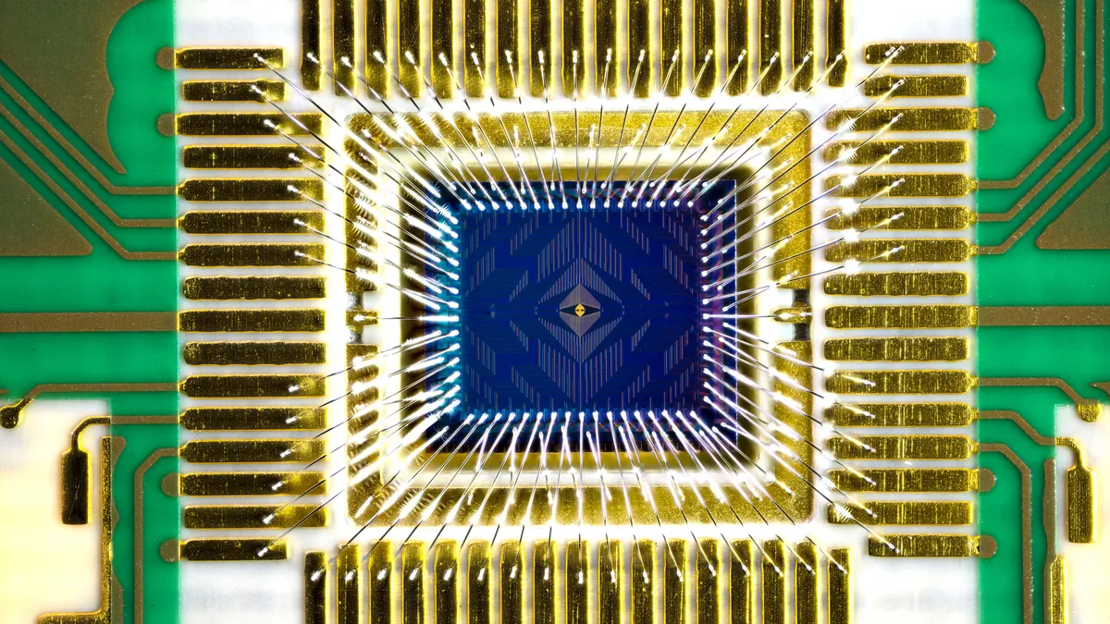

Intel quantum computing
Intel creates a 12-Qubit computer chip. Considered to be a low amount.
“Late to the party” but hopeful for a bright future at the top
Unlike rival companies, intel makes its qubits from individual electrons housed in the style of the normal CPU.
This thing reminds me of something… What could it be?

Slide 4

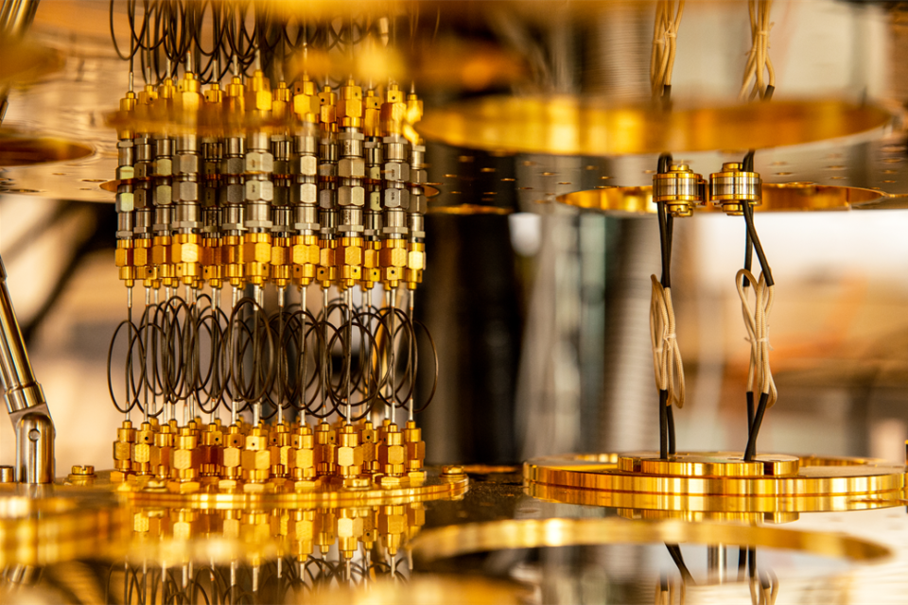
-Utilizes quantum mechanic to solve complex issues
-Qubits represent Quantum Particles.
-Qubits create the idea of quicker more precise information over the traditional “Bit”
what is quantum computing?

Slide 5

Why is this important?
AS STATED BEFORE, INTEL DID SOMETHING SPECIAL BY UTILIZING THE FORMATTING AND STRUCTURE OF THE REGULAR CPU.
Up to this point, quantum computers and household computers were separate things. Intel unified them! Which means that over the next 10 years or so, household quantum CPU’s will be a real thing!

Slide 6
references
cnet.com

